Slide 1

US Accidents- Data Analysis
Group 6

Slide 2
Dataset Description
Data across 49 states in USA
Traffic accidents from February 2016 to March 2019
Using two APIs which provide streaming traffic event data
Contains 2,243,939(2.24 million) rows and 49 columns
49 features of the dataset can be broken down into groups:
Accident Identifiers (Occurrence)
ID, Source, TMC(Traffic Message Channel), Start Time, End Time, Start Lat, Start Lng, End Lat, End Lng,Time-zone, Description and Address fields
Severity, Distance
Factors
'Weather_Timestamp’, 'Temperature(F)', 'Wind_Chill(F)', 'Humidity(%)', 'Pressure(in)’, 'Visibility(mi)', 'Wind_Direction', 'Wind_Speed(mph)’, 'Precipitation(in)', 'Weather_Condition', 'Amenity', 'Bump', 'Crossing’, 'Give_Way', 'Junction', 'No_Exit', 'Railway', 'Roundabout', 'Station’, 'Stop', 'Traffic_Calming', 'Traffic_Signal', 'Turning_Loop’, 'Sunrise_Sunset', 'Civil_Twilight', 'Nautical_Twilight’, 'Astronomical_Twilight'
Accident Identifiers (Type)

Slide 3
Dataset Cleaning
Drop Columns
‘Turning Loop’, ‘Country’, 'Source', 'End_Lat', 'End_Lng’, ‘TMC’, 'Civil_Twilight', 'Nautical_Twilight', 'Astronomical_Twilight’, 'Weather_Timestamp’, 'Airport_Code’
Turning Loop and Country have only one value. Remaining fields won’t make much sense in our analysis
Rename Columns
'Number’ to 'Street_No’ & 'Street’ to 'Street_Name’
Renaming columns to make more sense out of them
Handle Null
Fill ‘Unknown’ for null values in Street_No, Description, City, Zipcode
Street No has derived value from Description
Description is null for only one row
For City we know the other address (zipcode and street name) fields
Zip-code is null for 880 but they have city or street name or street no or description updated
New Columns
New field for ‘Duration’ of accident from Start Time and End Time
Duration implies time needed to clear or normalize the accident impacts

Slide 4
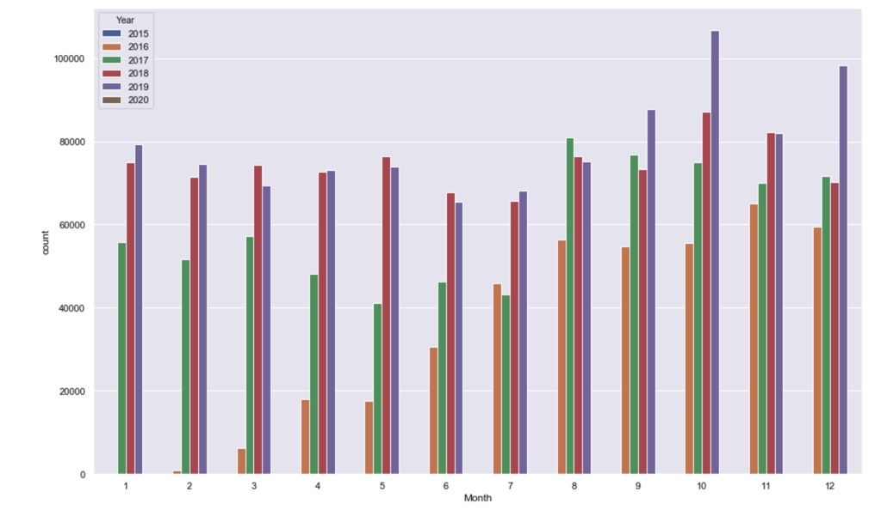
Accident count by month and year

Slide 5
Finding 1: Analyzing raw data to find location and impact

Slide 6
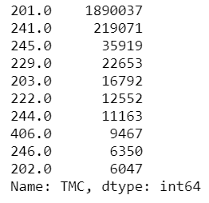
Accidents as reported
Accidents are reported using Traffic Message Channel (TMC) is a technology for delivering traffic and travel information to motor vehicle drivers. It is digitally coded using the ALERT C or TPEG protocol into RDS Type 8A groups carried via conventional FM radio broadcasts.
More information: https://wiki.openstreetmap.org/wiki/TMC/Event_Code_List
201 | (Q) accident(s)
203 | multi-vehicle accident (involving Q vehicles)
229 | (Q) accident(s). Slow traffic
241 | (Q) accident(s). Right lane blocked
245 | (Q) accident(s). Two lanes blocked

Slide 7
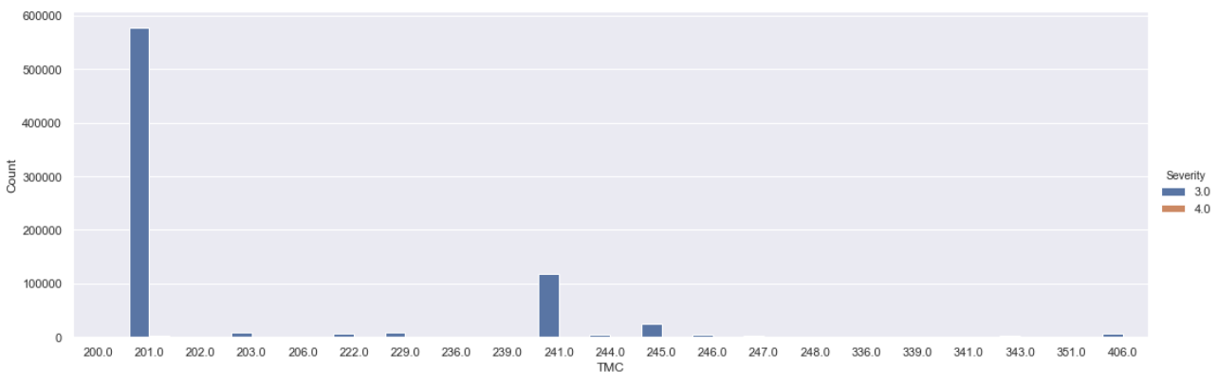
Accidents as reported
Accidents are reported using Traffic Message Channel (TMC) is a technology for delivering traffic and travel information to motor vehicle drivers. It is digitally coded using the ALERT C or TPEG protocol into RDS Type 8A groups carried via conventional FM radio broadcasts.
More information: https://wiki.openstreetmap.org/wiki/TMC/Event_Code_List
201 | (Q) accident(s)
203 | multi-vehicle accident (involving Q vehicles)
229 | (Q) accident(s). Slow traffic
241 | (Q) accident(s). Right lane blocked
245 | (Q) accident(s). Two lanes blocked

Slide 8
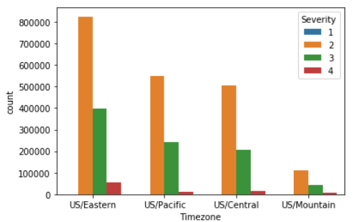
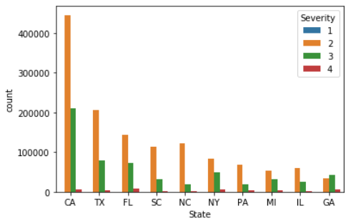
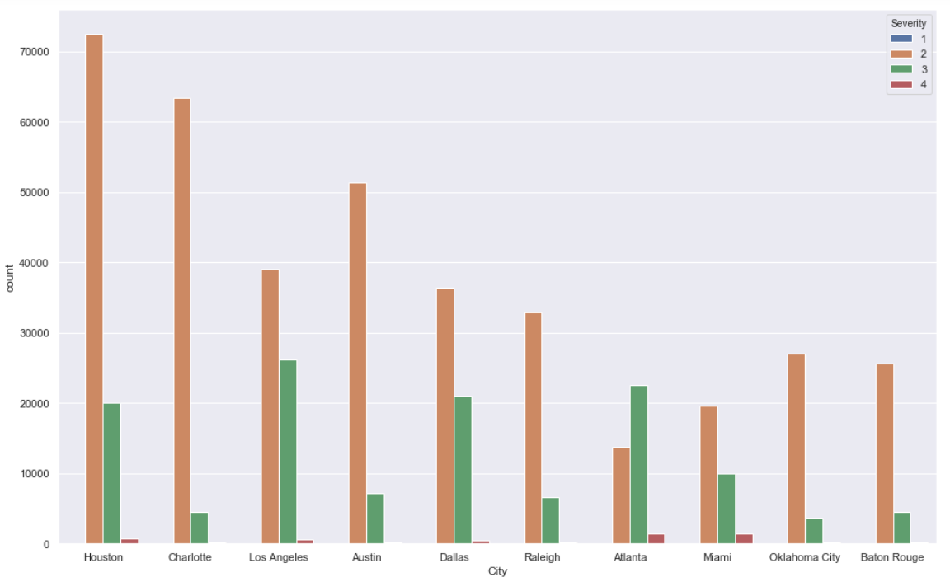
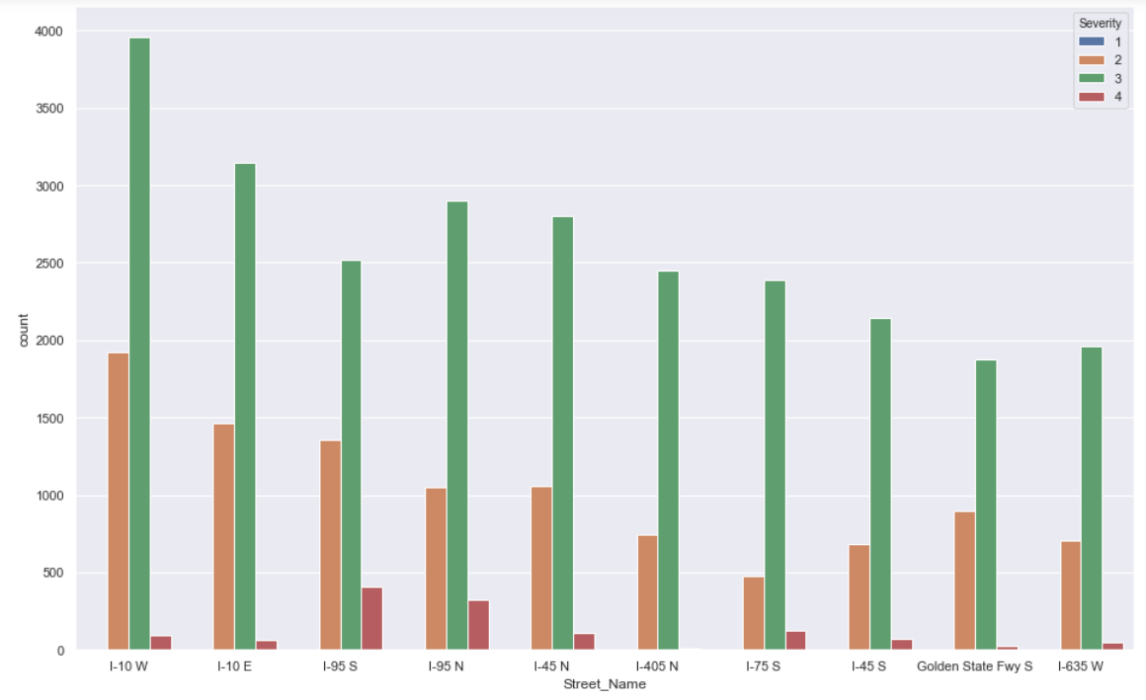
Top 10 streets having most accidents

Slide 9

Top 10 streets of top 10 cities having maximum accidents in US from Feb 2016 to March 2018 have 76% of severity 3 accidents

Slide 10
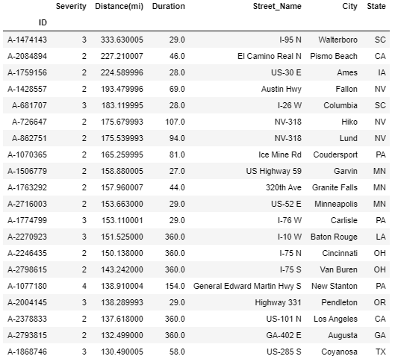
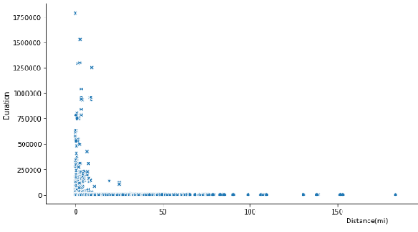
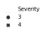
Role of severity, duration and distance 1
Severity 3 accidents show higher distance but smaller duration
Severity 4 accidents show low distance and higher duration in only a few cases
Duration distance and severity don’t seem to have much relation
Long duration and larger distance may also mean blockage or accumulation of traffic and hence are not related to accident severity
Abnormally large distance have shown understandable time delays
Abnormal time delays may mean API issues

Slide 11
Role of severity, duration and distance 2
How duration and distance change for top 10 streets for top 10 cities
Does Duration distance and severity show any interesting feature?

Slide 12
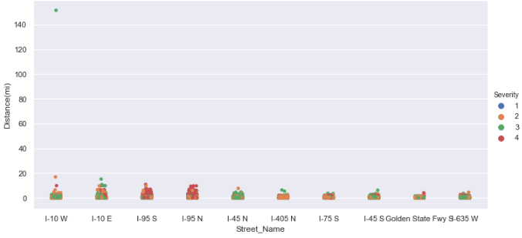
Role of severity, duration and distance 2
Distance as no relation with type of accident severity

Slide 13
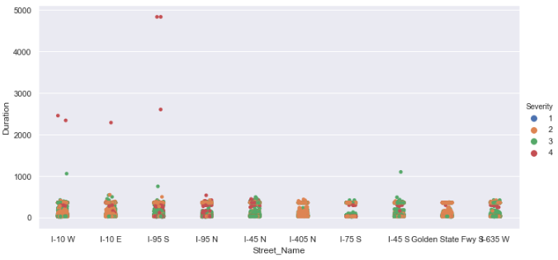
Role of severity, duration and distance 2
Some severity 4 accidents show long time of recovery but not for all

Slide 14
Role of severity, duration and distance 2
US/Eastern followed by US/Pacific have major accident count
States CA & TX top the charts for most accidents
City Atlanta has more severity 3 accidents whereas Los Angeles has maximum severity 3 accidents
Top 10 streets of top 10 cities having maximum accidents in US from Feb 2016 to March 2018 have 76% of severity 3 accidents
TMC indicates that most accidents impact right and left lanes and lead to slow traffic
Severity, Duration and Distance are not correlated
Some severity 4 accidents show long time of recovery but not for all

Slide 15
Finding 2: Weather factors affecting accidents

Slide 16
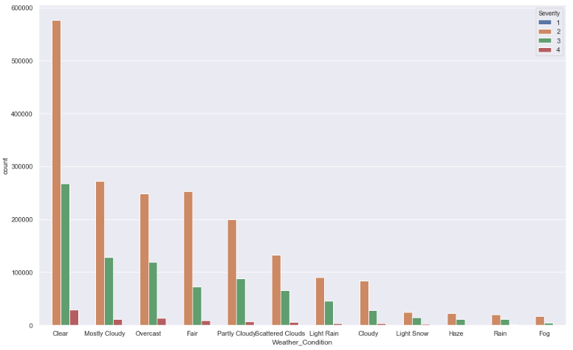
Factors affecting accidents- Weather
Column- Weather_Condition Shows the weather condition (rain, snow, thunderstorm, fog, etc.).
Replaced all the NaN values of that column with ‘Clear’
Interesting finding: Across all levels of severity, most accidents happen under clear, cloudy, fair or similar weather conditions. These conditions are considered benign compared to rain and snow.

Slide 17
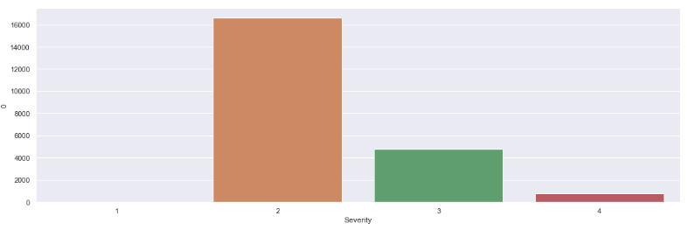
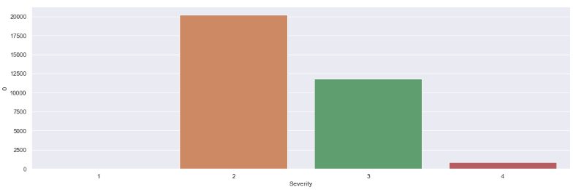
Accident Severity in different Weather Conditions
Under Fog
Under Rain

Slide 18
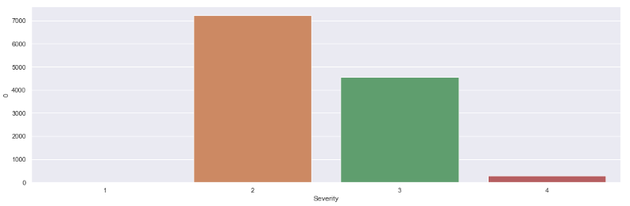
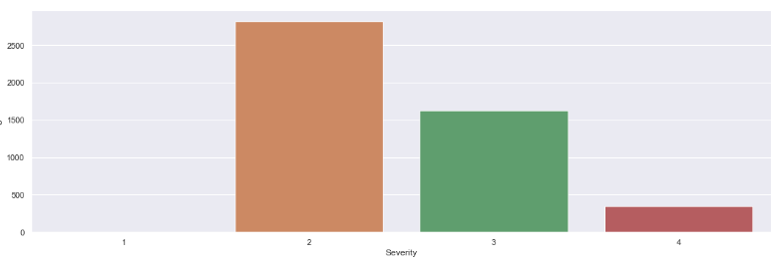
Accident Severity in different Weather Conditions
Under Heavy Rain
Under Snow

Slide 19
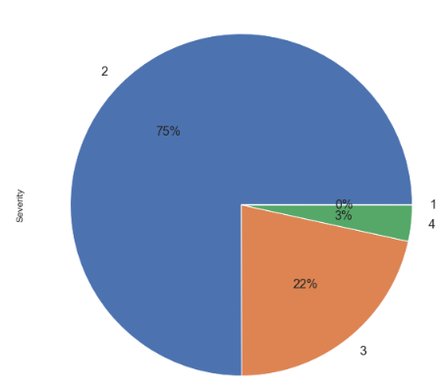
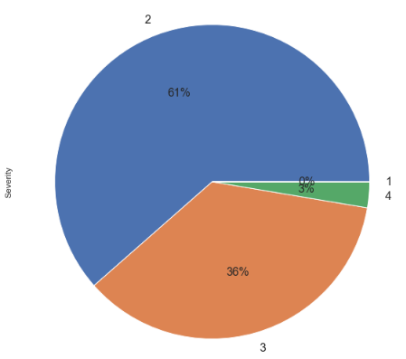
Accident Severity in different Weather Conditions
Under Fog
Under Rain

Slide 20
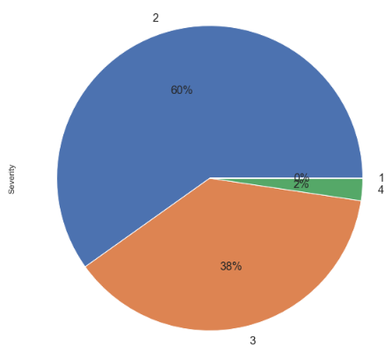
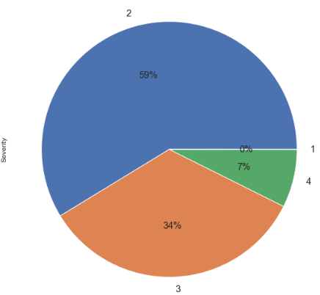
Accident Severity in different Weather Conditions
Under Heavy Rain
Under Snow
Conclusion: The proportion of level 3 and 4 accidents increases as weather changes from fog (25%) to light rain (36%) to rain (39%) to heavy rain (40%) to snow (41%).

Slide 21
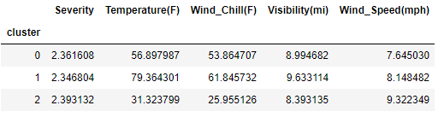
Weather factors affecting accidents
Analyzed the effect of these factors on the mean severity using Kmeans clustering with 3 clusters.
For factors taken into consideration, the Null value have been replaced with median values

Slide 22
Weather factors affecting accidents
By this result we can see that mean severity of accidents is highest when:
1. Temperature is low.
2. Visibility is lowest.
3. Wind Speed is highest.
During these weather conditions the traffic controlling department should be alert and manage traffic in an efficient manner and also should make arrangements for more amenities.

Slide 23
Finding 3: Infrastructure Factors Affecting Accidents

Slide 24
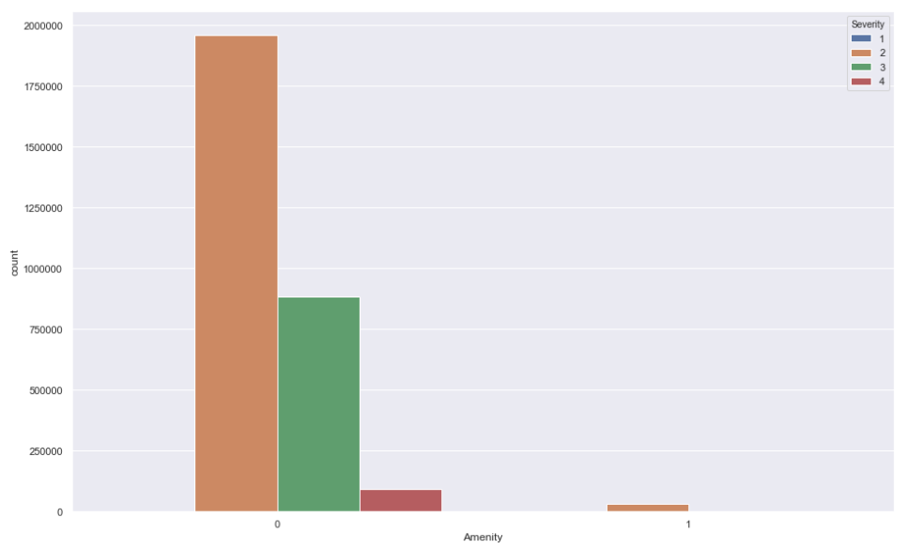
Infrastructure’s impact finding (1)
Concern factors: Amenity & Severity
Amenity: This feature indicates the presence of amenity in a nearby location.
Amenity is not available for most of the accidents of severity 2/3/4 (98.4%)
This is unfortunate, as there will be some time involved to get help

Slide 25
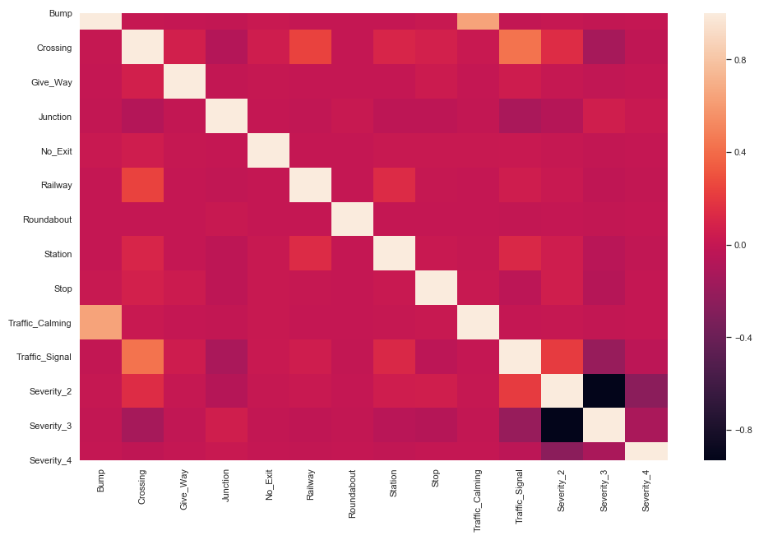
Infrastructure’s impact finding (2)
Concern factors: 'Bump', 'Crossing', 'Give_Way', 'Junction', 'No_Exit', 'Railway', 'Roundabout', 'Station', 'Stop', 'Traffic_Calming', 'Traffic_Signal’
Correlation gives 5 most important factors that are moderately correlated (low positive correlation:
Crossing, Junction, Station, Stop and Traffic_Signal

Slide 26
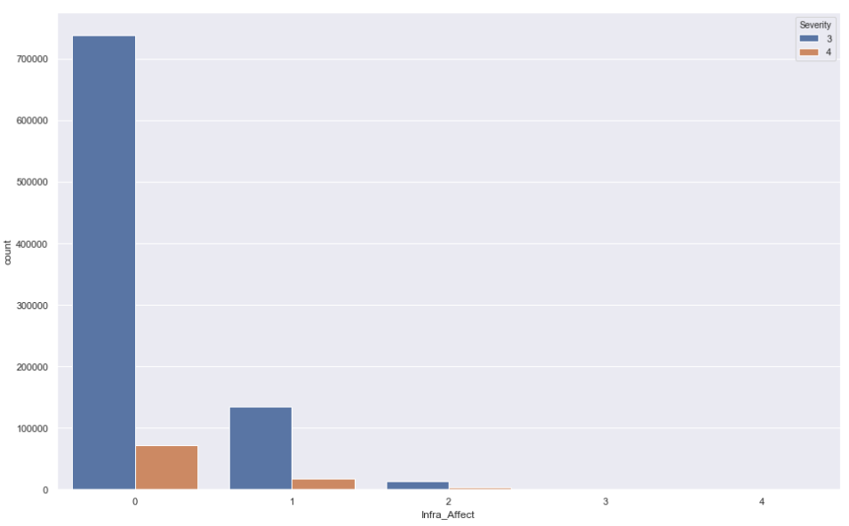
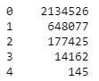
Infrastructure’s impact finding (2)
Calculating the cumulative Infrastructure Affect using the most correlated factors
Crossing, Junction, Station, Stop and Traffic_Signal
Most accidents have no factors to blame, some of them depend on 1 or 2 factors mostly Junction and Traffic Signal

Slide 27
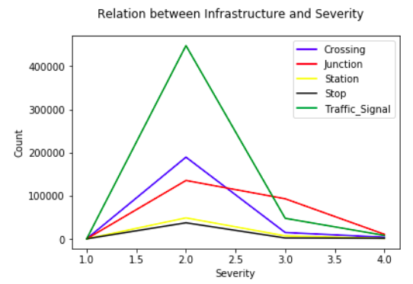
Infrastructure’s impact finding (2)
Concern factors: ‘Crossing', ‘Junction', Station, Stop, and Traffic_Signal. (5)
Aim: find in each severity level, every factor’s occurrence times.
Method: groupby and matplot.

Slide 28
Infrastructure’s impact finding (3)
Concern factors: Amenity, Bump, Crossing, Give_Way, Junction, No_Exit, Railway, Roundabout, Station, Stop, Traffic_Signal, Distance(mi), Severity. (13)
Aim: Using Clustering find any relationship between Infrastructure factors and severe accident.
Dataframe shape(2974335, 40 )

Slide 29
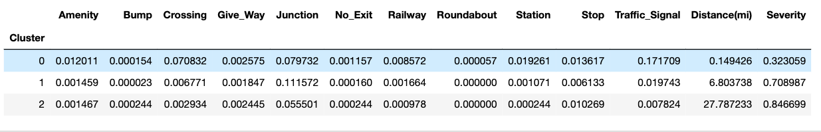
Infrastructure’s impact finding (3)
Concern factors: Amenity, Bump, Crossing, Give_Way, Junction, No_Exit, Railway, Roundabout, Station, Stop, Traffic_Signal, Distance(mi), Severity. (13)
Aim: Using Clustering find any relationship between Infrastructure factors and severe accident.
Dataframe shape(2974335, 40 )

Slide 30
Group data using K-means Clustering (include location cols)
Cluster 0
Start Latitude: 36.493305
Start Longitude: -95.427127
Distance: 0.29mi
Day-Time
Amenity
Duration: 97mins
Avg Severity: 2
Cluster 1
Start Latitude: 40.874121
Start Longitude: -82.415741
Distance: 2.97mi
Evening-Time
Factors: Junction
Duration: 805416mins
Avg Severity: 3/4
Cluster 2
Start Latitude: 40.102335
Start Longitude: -91.50883
Distance:3.02mi
Day-Time
Duration: 170072mins
Avg Severity: 2
Made a column determining accidents: Severity ½ → ‘0’ [No accidents]
Severity ¾ → ‘1’ [Accidents]
Severity, Start_Lat, Start_Lng, Distance(mi), Side, Timezone, Amenity, Bump, Crossing, Give_Way, Junction, No_Exit, Railway, Roundabout, Station, Stop, Traffic_Calming, Traffic_Signal, Sunrise_Sunset, Duration
By using the following columns in Forest Classifier, for prediction on random 70-30 of the data set AUC score was 0.92

Slide 31
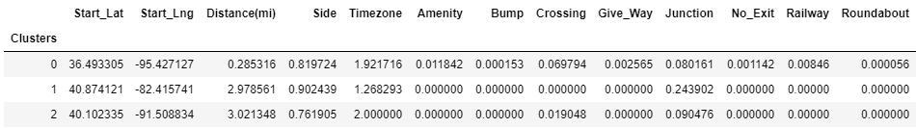
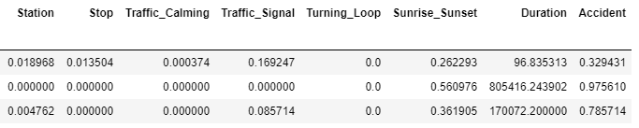
Group data using K-means Clustering (include location cols)
Cluster 0
Start Latitude: 36.493305
Start Longitude: -95.427127
Distance: 0.29mi
Day-Time
Amenity
Duration: 97mins
Avg Severity: 2
Cluster 1
Start Latitude: 40.874121
Start Longitude: -82.415741
Distance: 2.97mi
Evening-Time
Factors: Junction
Duration: 805416mins
Avg Severity: 3/4
Cluster 2
Start Latitude: 40.102335
Start Longitude: -91.50883
Distance:3.02mi
Day-Time
Duration: 170072mins
Avg Severity: 2
Made a column determining accidents: Severity ½ → ‘0’ [No accidents]
Severity ¾ → ‘1’ [Accidents]
Severity, Start_Lat, Start_Lng, Distance(mi), Side, Timezone, Amenity, Bump, Crossing, Give_Way, Junction, No_Exit, Railway, Roundabout, Station, Stop, Traffic_Calming, Traffic_Signal, Sunrise_Sunset, Duration
By using the following columns in Forest Classifier, for prediction on random 70-30 of the data set AUC score was 0.92

Slide 32
Managerial Insights
Presence of amenity is needed in most locations that have accidents
Crossing, Junction, Station, Stop, and Traffic_Signal have minor impact on accidents. Severity 3 accidents have effect of junction. Whereas severity 2 accidents have effect of Crossing and Traffic Signal
Some locations that have come in clustering need serious analysis of all infrastructure
The API that record data of accident need to checked for proper recording and some impact fields need to be added

Slide 33
Limitations
The dataset has no strongly correlated impact fields for accident.
The distance and duration have junk values. This may be due to some malfunctioning of the API

Slide 34
Thank You

